Slide 1

Prime & Palindrome
Team SCV – Chu Jae Hun

Slide 2
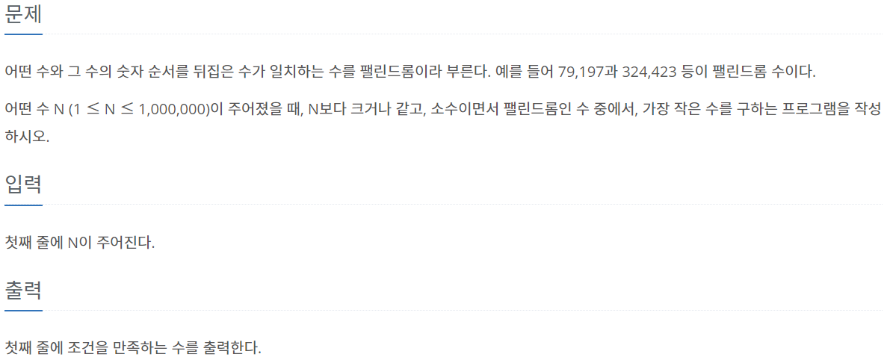
About Problem..

Slide 3
Idea..
1 <= n <= 1,000,000 ? -> Eratosthenes Sieve
Palindrome 역순 비교

Slide 4
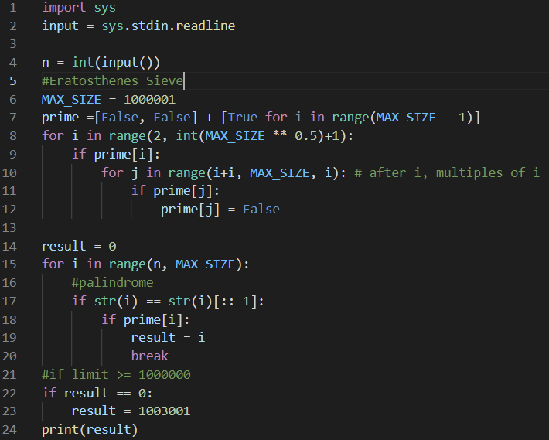
Procedure..
Eratosthenes sieve algorithm (MAX = 1000001)
Palindrome algorithm (역순비교)
If prime num? -> break
If n == 1000000
-> 1000000이상의 prime & palindrome = 1003001

Slide 5
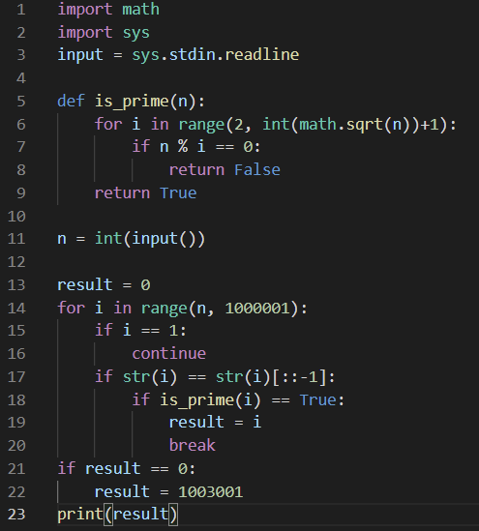
Another Way..
다른 소수 판별 방법 (절반까지 확인) O(X^0.5)

Slide 6
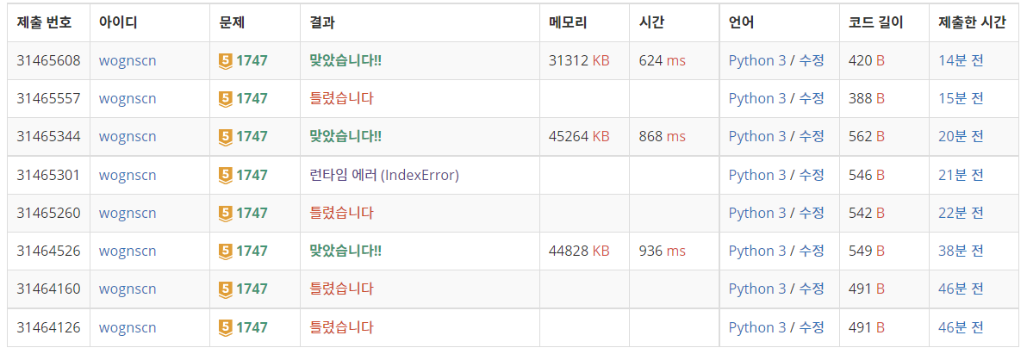
Result/Feedback
sqrt 방법

